Slide 1


Interface and Workflow Settings with System Center 2012 SP1 Orchestrator Andreas Rynes Datacenter Architect Microsoft Corporation
Microsoft Virtual Academy
Notes:
Welcome to this second session of System Center 2012 Orchestrator, we are today covering interfaces and workflow settings with System Center 2012 SP1 Orchestrator, my name is Andreas Rynes, I’m a datacenter architect in the worldwide datacenter private cloud center of excellence and today I would like to cover that objectives.

Slide 2
Objectives
Review the console interfaces available in SCO
Describe SCO settings and features that affect workflows and workflow creation
Notes:
First of all I would like to read you the console interfaces that are available in Orchestrator as well as describing the Orchestrator settings and features that really affect the workflows and creation of workflows.
Objectives
Start Time 00:01 / Length: 1 minute
Microsoft Lync tools used on this page:
None
Review the learning objectives.

Slide 3
Agenda
Creating Runbooks
Working with the Runbook Designer
Using the Runbook Tester
Orchestration Console
Integration Packs
Global Settings & Configuration
Anatomy of a Runbook
SCO Databus
Data Passing Between Runbooks
Securing Runbooks
Notes:
So the agenda for this call is talking a little bit how to create runbooks, how to work with the runbook Designer then we are going to cover the runbook tester the tool to test your runbooks, then we would like to discuss the Orchestration Console, a little bit about integration packs which we covered in the first session already but we will have a look here on that as well, then we will talk about global settings and configurations, then we would like to talk about the runbook and how that runbook looks like and what are the different parts of a runbook. Then we will discuss one very important idea behind Orchestrator the databus and how that works and how that helps passing data between runbooks and at the very end we’re talking about how to secure your runbooks.
IPv6 Subnet and Address Planning
Start Time 00:04 / Length: 3 minutes
Microsoft Lync tools used on this page:
None
Take the students through the subnet and address plan. Explain the various stages of how the plan comes together.

Slide 4
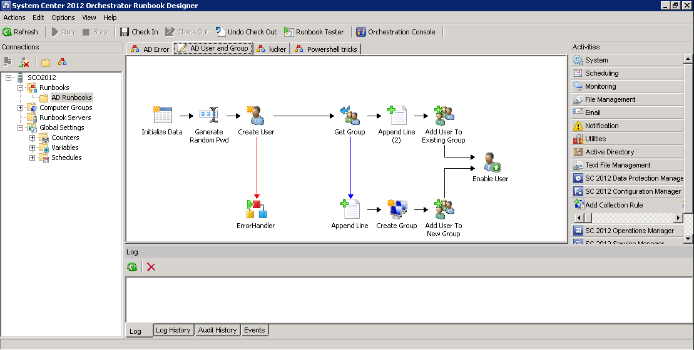
Runbook Designer
Create, manage, and run runbooks
Documented, end to end process view
Drag and drop GUI workflow designer
Branching and parallel processing
Notes:
So the Runbook Designer is the tool that you’re going to use to create, to manage and to run your runbooks, it’s actually what you see on the right screen shot shows you in the middle part of that tool you see the surface where you are able to create your runbooks, where you’re able to drag and drop your activities to that pane and create that runbook. It’s really actually an end to end process view you have the user interface, you’re using drag and drop, and you’re also able to do some branching and parallel processing within the Runbook Designer.

Slide 5
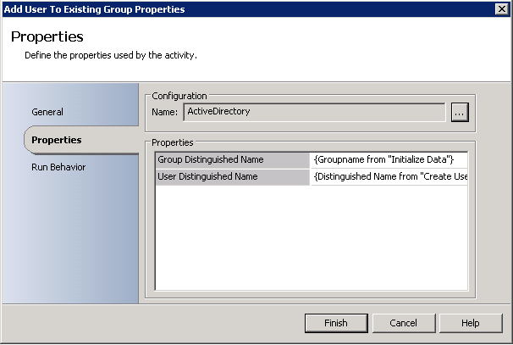
Creating Runbooks
Form-based dialogs
No hard-wired scripts
No programming knowledge required
Notes:
So to create runbooks, it’s actually based on forms and wizards so there is no need actually to write scripts or to develop some code as long as the integration packs and the activities are able to fulfill your requirements you’re really able to drag and drop those activities and build your workflows without any coding and so there is no really programming knowledge required for creating runbooks.

Slide 6
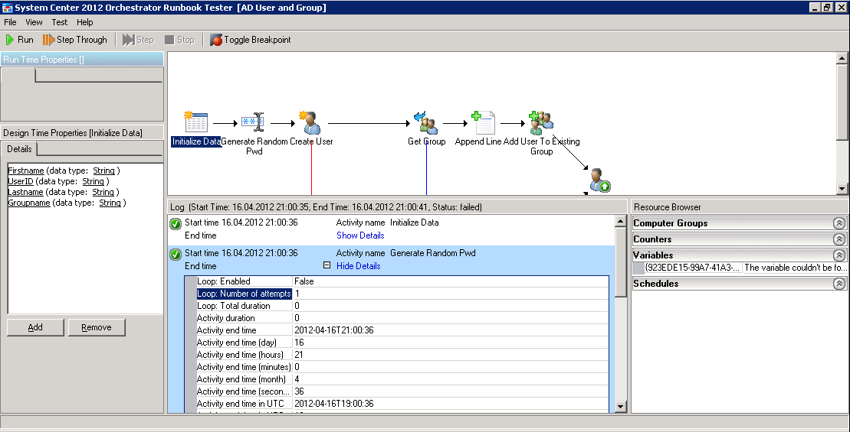
Runbook Tester
Called by Designer
Step through object-by-object
Nested workflows cannot be tested
Notes:
The Runbook Tester, it’s actually called by the Designer so there is a button in the Designer where you are able to start the Runbook Tester and that will give you a step-through object-by object within your workflows so you really able to debug your workflow and to see each activity and the data that is part of that activity, the only limit is that nested workflows cannot be tested here, but for all other workflows you can use that tester to debug your workflows and see what’s going on with your data within that runbook.

Slide 7
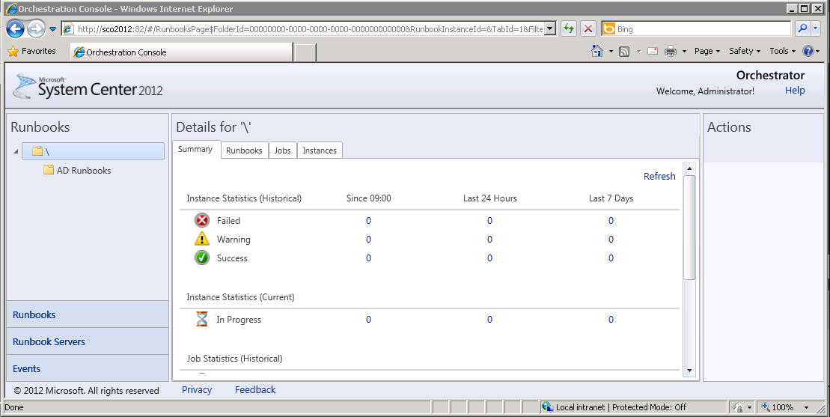
Orchestrator Console
Web Interface with which you can:
See which runbooks are running
View real-time runbook status
Start or stop runbooks
Notes:
So the Orchestrator Console, it’s actually a web interface where you’re able to see the runbooks you see which one are running, you’re able to see the real time runbook status of the runbooks and last but not least you’re able to start and stop your runbooks within the Orchestrator Console and that web interface is actually using the REST-based web service that’s also part of the Orchestrator architecture.

Slide 8
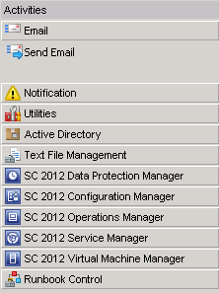
Integration Packs
Extend out-of-the-box functionality of Orchestrator
Vendor specific integration packs
Auto detection of data, schemas, forms and fields
Integration Packs which are included in the download are supported and updated by Microsoft
Notes:
So integration packs extends the out of the box functionality of Orchestrator so those are vendor specific integration packs and activities so on the very right you see the activity pane of the Orchestrator Designer and a couple of those, they’re really out of the box like the e-mail part, notification, utilities, text file management and at the very end you see the runbook control, those are the activities that are part of Orchestrator out of the box. But things like Active Directory and for System Center 2012 components are part of integration packs that you will only see if you have imported integration pack into your environment. So integration packs which are included in the download are supported and updated by Microsoft so you’re able to see that.

Slide 9
Global Settings & Configuration
Variables
Store Global information for use in all objects
Save time
Write once, deploy everywhere
Update cascades wherever the variable is used
Schedules
Specify a time range that can be used to prevent or allow your runbooks and objects to run at specific times
Notes:
So Global Settings and Configuration, so it’s that concept of variables so if you are familiar with coding and programming you probably know all about variables, those variables helps you to store global information that you’re going to use in all your objects. That helps you to save time, you have to only write them once and deploy it everywhere and also if you have to update those data in your variables you have to just update that once and not in every runbook.
Another concept is the concept of schedules so you are able to specify specific time ranges that can be used either to prevent or allow your runbooks and objects to run at specific times so you’re able within your runbooks to test against that specific schedule and if that is within that schedule you’re able to do some other action to do some specific activities.

Slide 10
Global Settings & Configuration
Counters
Numeric values that count occurrences of events or attempts of action
Can be incremented, decremented, set, reset or monitored for change by runbooks
Computer Groups
Enable you to target runbooks to similar sets of computers
Notes:
Another concept of Orchestrator are counters, actually those store numeric values that count occurrence of events or attempts of action, they can be incremented and decremented set and reset and also monitored for change by runbooks so you’re able to monitor a specific counter and if that counter goes to specific value you’re able to start a runbook for example.
And then another concept are Computer Groups that really enables you to target runbooks to a similar set of computers so you’re able not to specify only one computer but you’re able to specify a computer group and to target more than just one computer with your runbooks.

Slide 11
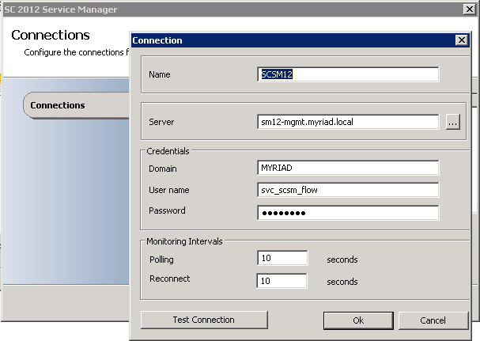
Global Settings & Configuration
Global Configuration items are settings specific to an Integration Pack
Configuration is usually connection-related info for a specific target system
Settings can be accessed in the Designer
Notes:
So Global Configuration items are settings specific to an integration pack so if you are defining connections for example you see the Service Manager integration pack you’re defining your connection to a specific service manager instance or a server, management server, so those can be accessed in the design of those settings and you’re able to use them within your activities so you’re able to run your runbooks against different management servers for example if we talk about the service manager example. So those are specific to the integration pack those connections and you can define a couple of those and use them in your runbooks differently.

Slide 12
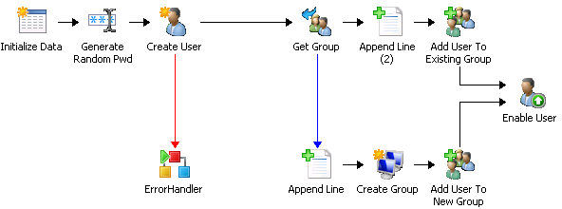
Anatomy of a Runbook
Runbooks are visual representation of automated datacenter procedures
Created in the Designer by dragging and dropping objects into a design workspace and connecting them with links
Objects perform a specific action which is executed by the Runbook Server
Links are used to connect objects and create the order in which they are triggered
Objects and links can be configured to reference Variables, Counters and Schedules
Notes:
Policies are visual representations of your datacenter processes as they are automated in OIS. Policies are built by dragging and dropping objects and connecting them with links. When triggered, each object performs an action. Once an object has completed it will output one or more data elements and trigger any objects that are linked to it. Policies can only contain one starting point.
Objects
Each object performs a specific action when it is executed by the Action Server. To use an object, drag and drop it to the Policy, configure its properties, and link it to the object that will trigger it. For example, the Send Email object is used to send email through an SMTP server. To use the Send Email object you configure the recipients, subject, message body, and the SMTP server. All objects produce data that is published to the databus. This data will automatically be made available to objects further down the flow and is not configurable.
Some objects are triggered by external applications and cannot be triggered by another object. These objects are called Monitors. Monitors are used at the beginning of Policies to create start conditions. For example, the Monitor Folder object will wait for the files within a specified folder to change. When a file changes the Monitor Folder object will trigger the next object in the Policy. Because Monitor type objects cannot be triggered by other by other objects, they will always have 0 imputs and 1 output, although output may be multi-valued output.
Links
Links are used to connect objects and create the order in which they are triggered. Links can be configured with Link Conditions that will filter data from the previous object in the Policy. The filters can test any data published to the Databus. With Link Conditions, you can build automatic decision making in your Policies. When objects linked, each object can subscribe to data published by any object before it
Note: Policies, folders, objects, links, variables, counters and schedules are identified in the datastore by GUID. As a result, if you rename any of these elements in OIS Client and the references within policies will remain intact.
TRANSCRIPTION STARTS HERE
So let’s talk a little bit about runbooks, so runbooks are visual representations of automated datacenter procedures so when you think about a specific task or a specific procedure in your datacenter that you do manually today and you would like to automate that, that’s probably part of one runbook of course it depends on the complexity you might have a couple of different runbooks involved but a runbook really is the representation of a specific procedure you want to automate.
So you start doing that by creating that runbook in the runbook designer by dragging and dropping those objects into that design pane and surface and connecting them with links and those activities, those objects perform a specific action and that’s executed by the runbook server. And the links, just make sure that they are the activities and objects are created in the right order in which they should be triggered and they are connecting those objects together so for example the create user activity, the third one from the left you see on your screen, that will create an Active Directory user and depending on the output if that was successful or not it may go in a different direction so we have two different links here, the red one that’s obviously happened when create user was not successful, it will go down to the error handling activity, actually this one will call another runbook and if it’s successful then it will go to the Get Group and you’re able to use Variables, you’re able using Counters and you’re able to using Schedules in that links for example so you’re able to grab stuff out of variables for examples but you’re also able to react on the output and the published data of the activities so Create User publish and error state for example for the databus you can grab that error state variable from Create User and see what’s the content, what’s in there and if it was for example zero which it was successful you’re able to go to Get Group and if it’s not successful you’re able to go down to the error handling activity.
So that’s actually the way how to build a runbook, how to automate your procedures and how to work with objects and links to bring that together to a runbook that’s executed by a runbook server at the very end.

Slide 13





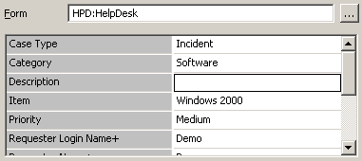
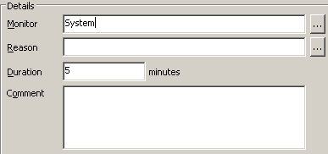
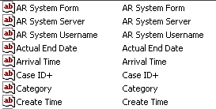
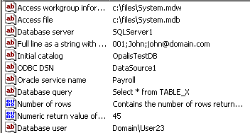
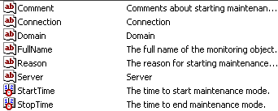
Orchestrator Databus
A mechanism that passes information from one activity in a runbook to another activity.
Full line as a string
Full line as a string
Category
Databus
Notes:
So one concept we have discussed already a little was the Orchestrator Databus and that’s actually a very important concept within Orchestrator and it’s really important to understand what’s happening here. So if you think of a workflow of a runbook you want to pass information from one activity to the next one and to the next one and so on, but within Orchestrator you don’t have to worry about all that, that happens automatically by using the concept of the databus. So databus really passes information from one activity in a runbook to another activity. So this example shows a database that will pass activity from one runbook to the next and the next activity this guy here takes data out of the databus and also publish data to the databus as part of it’s own activity. And the third activity will also grab data out of both activities that happened before and will use that within it’s own activity and at the end will also publish data to it’s own bus and the very last one that’s on the slide, the fourth activity will be able to grab data of all of those three activities that happened before so you don’t have to worry about how data will be passed within a runbook as long as you’re using the links to connect those objects that they’re able to pass in those information to the next one.

Slide 14
Data Passing Between Runbooks
Data can be passed between runbooks
Accomplished using ‘Invoke Runbook’ and ‘Return Data’ objects
Invoke Runbook – will run a runbook you have specified.
Pass data to the triggered runbook via custom start object
Return Data – Allows publishing data from child runbook to parent runbook
Notes:
So that’s around how to work with data within the runbook but you’re also able to pass data within the runbook and that happens with two objects or two activities, one if the invoke runbook and the second one is the return data object. So you’re using the invoke runbook within a runbook to start or to trigger a different runbook and there you’re able to pass in information from the databus and pass those information to the triggered runbook. And if that triggered runbook would like to pass information back to it’s parent runbook then it will use the return data activity to really allow publishing data from child to parent so those two activities are used to passing data between runbooks and the databus is really for passing data within a runbook.

Slide 15
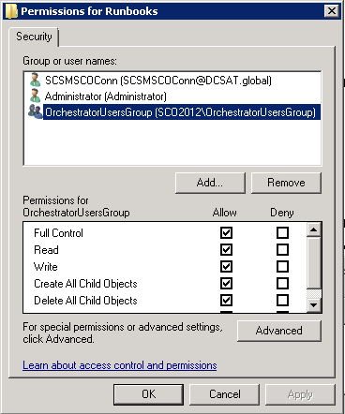
Securing Runbooks
Orchestrator Users group
Full access to a runbook
Individual users can be granted access
Runbooks and Folder level
Secured with permissions
Users Authenticated via AD Authentication
Permissions
View and run the runbook
Change the runbook
Change permissions for runbook
Notes:
Last but not least, promised talking a little bit about security within runbooks, first of all there’s no Orchestrator user group that has full access to the runbooks and you can really grant permissions for individual users on runbooks and folder level and they are really secured by permissions and those permissions can be few and run the runbook, change the runbook or change permissions for runbook and using Active Directory authentication to make that happen so that’s how security works within Orchestrator and how to secure your runbooks.

Slide 16
Summary
Understanding Workflow Basics
Discussion of Orchestrator Consoles
Runbooks Modes and Behavior
Data publishing on the databus
Data passing between runbooks
Review How to Secure Runbooks
Notes:
So short summary of that second session about Orchestrator, I think we’ve covered the basics, how to build the runbooks, we have discussed the Orchestrator Consoles that are available, how you’re going to use them then we have discussed the runbooks, how they are going to look like and the behavior, how data is passed between activities within the runbook as well as how you’re passing data from one runbook to another one, and also how to secure the runbooks.

Slide 17
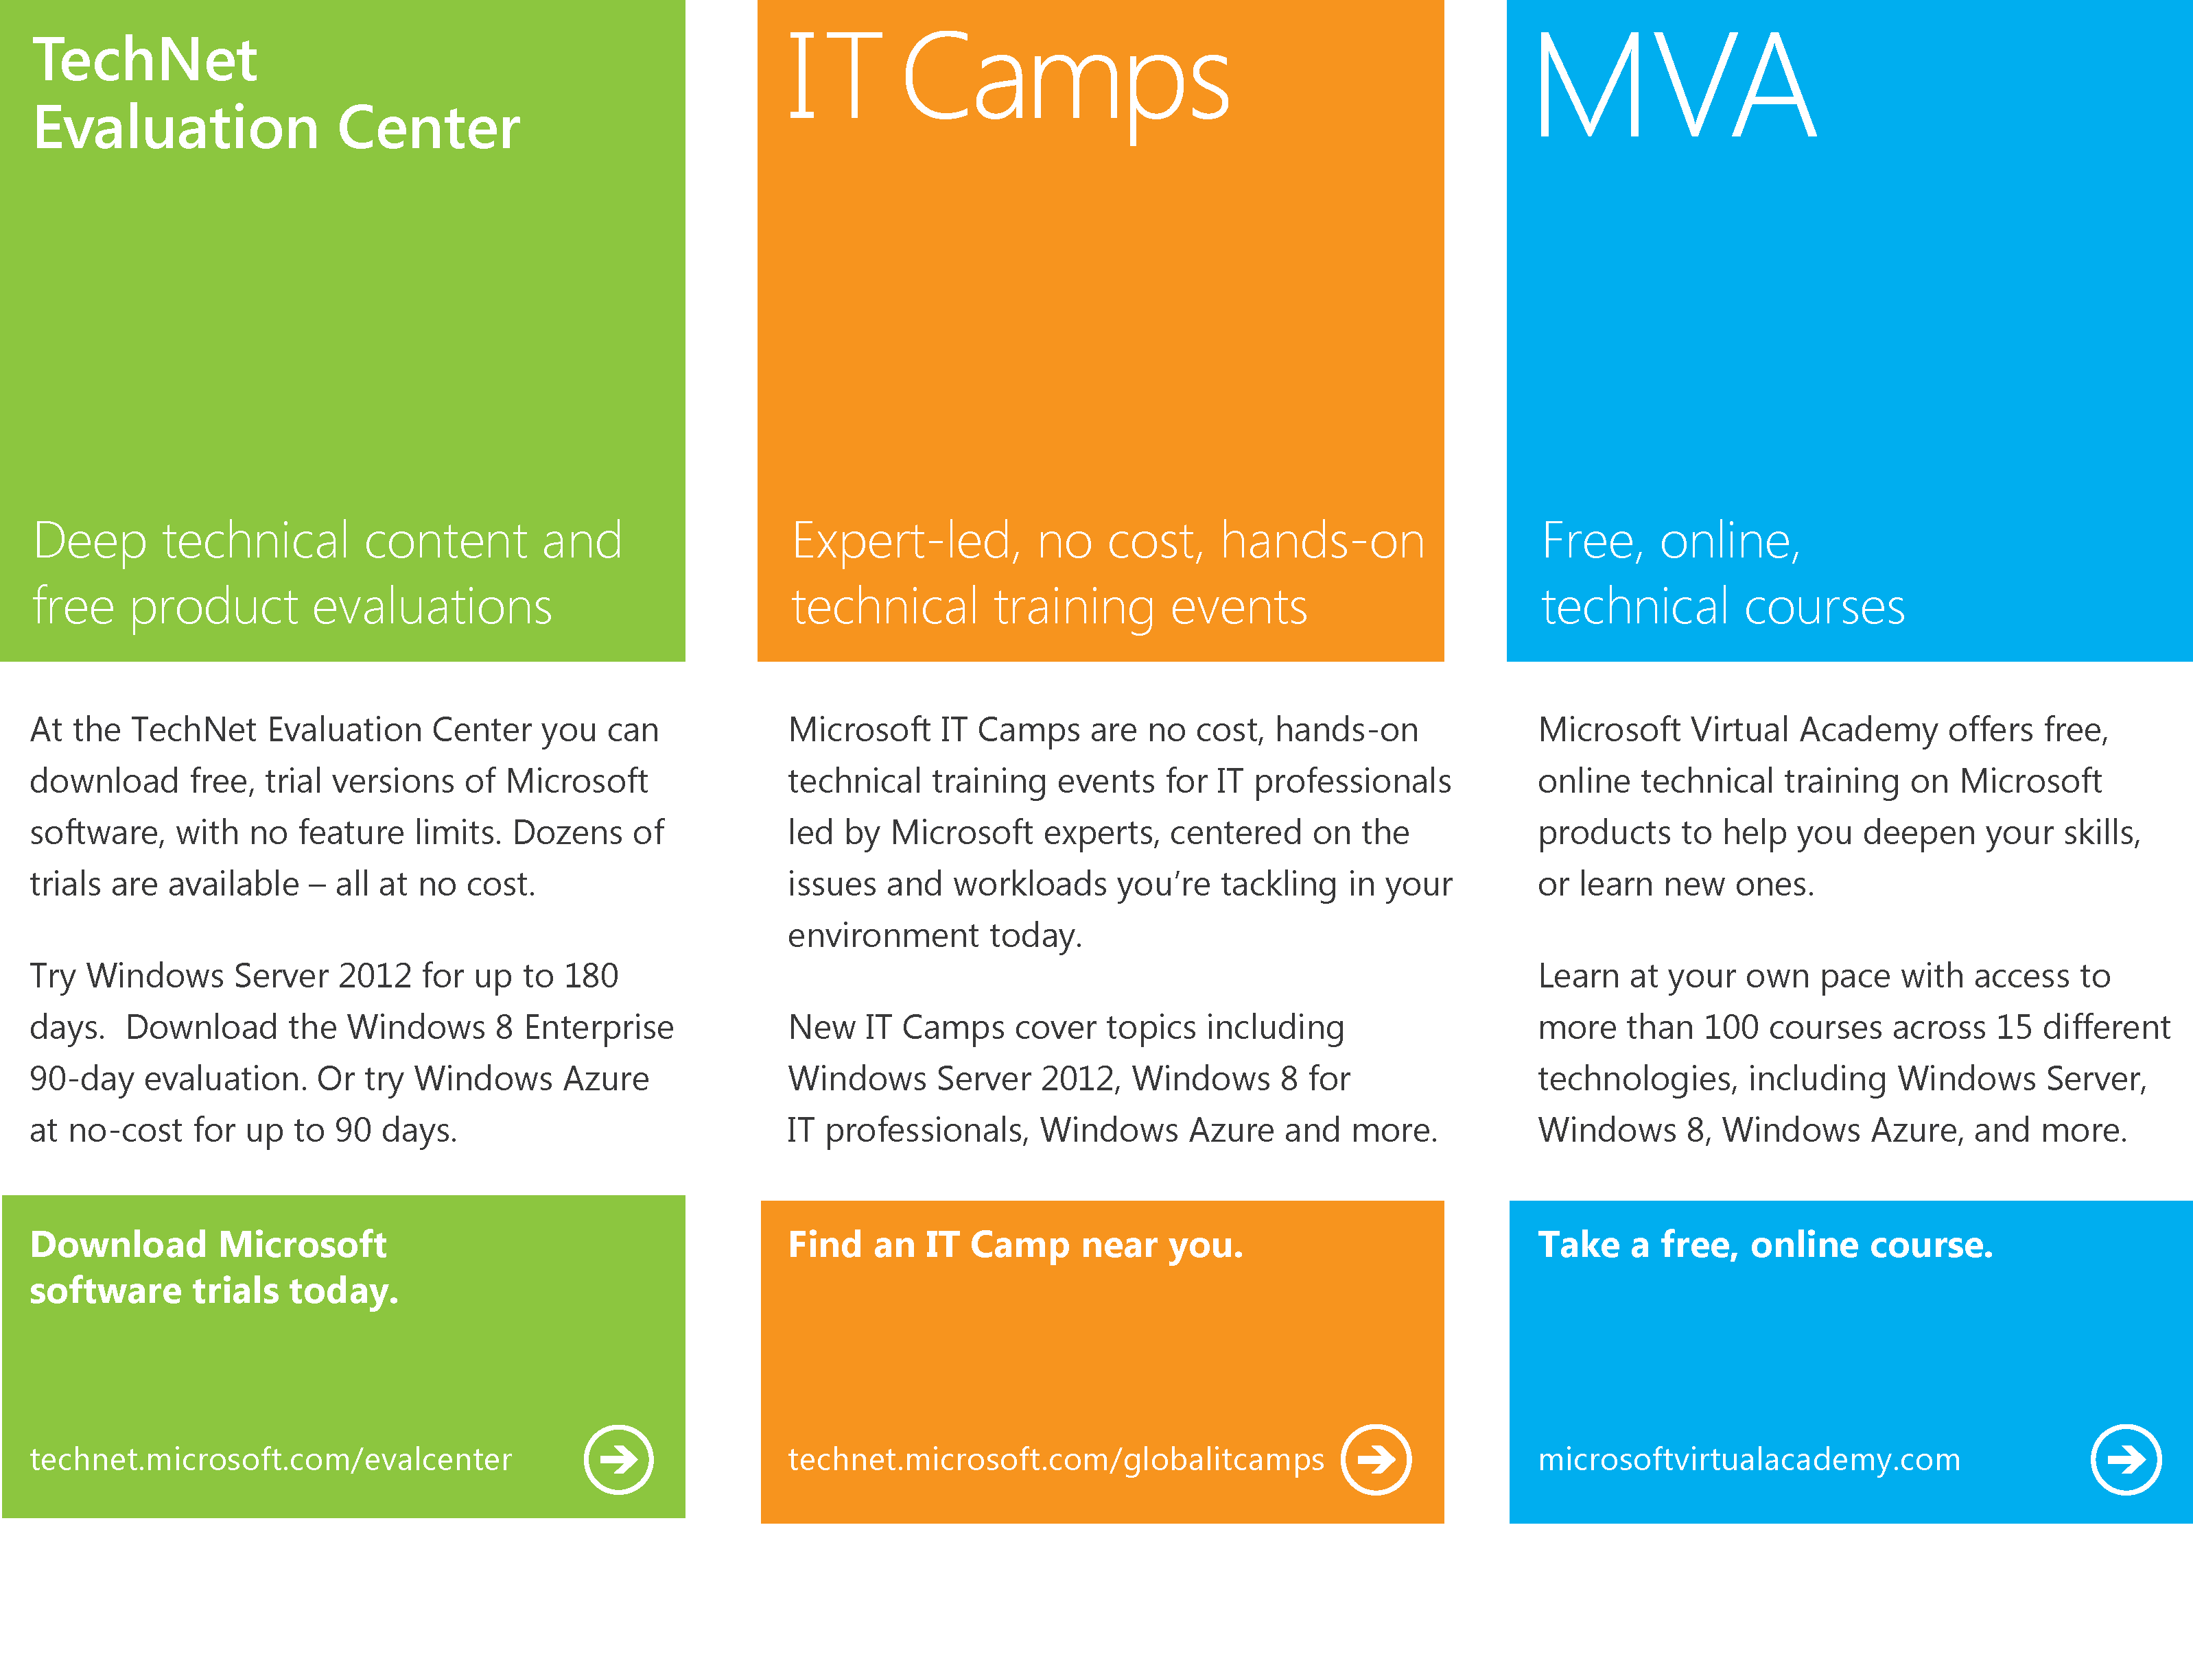
Notes:
With that, I would like to highlight again the TechNet eval center where you will find a lot of free trial versions of Microsoft software at no cost at technet.microsoft.com/evalcenter. Another opportunity to get no cost hands on technical training is the IT camps website which can be found on the technet.microsoft.com/globalitcamps and last but not least of course the online technical courses on Microsoft Virtual Academy which you will find on microsoftvirtualacademy.com

Slide 18

© 2012 Microsoft Corporation. All rights reserved. Microsoft, Windows, Windows Vista and other product names are or may be registered trademarks and/or trademarks in the U.S. and/or other countries.
The information herein is for informational purposes only and represents the current view of Microsoft Corporation as of the date of this presentation. Because Microsoft must respond to changing market conditions, it should not be interpreted to be a commitment on the part of Microsoft, and Microsoft cannot guarantee the accuracy of any information provided after the date of this presentation. MICROSOFT MAKES NO WARRANTIES, EXPRESS, IMPLIED OR STATUTORY, AS TO THE INFORMATION IN THIS PRESENTATION.
Notes:
So thanks for joining today on the second session and see you on the next session about Orchestrator 2012.

